Slide 1
Computer Architecture: What is a computer?
Dr. Colin O’Flynn

Slide 2
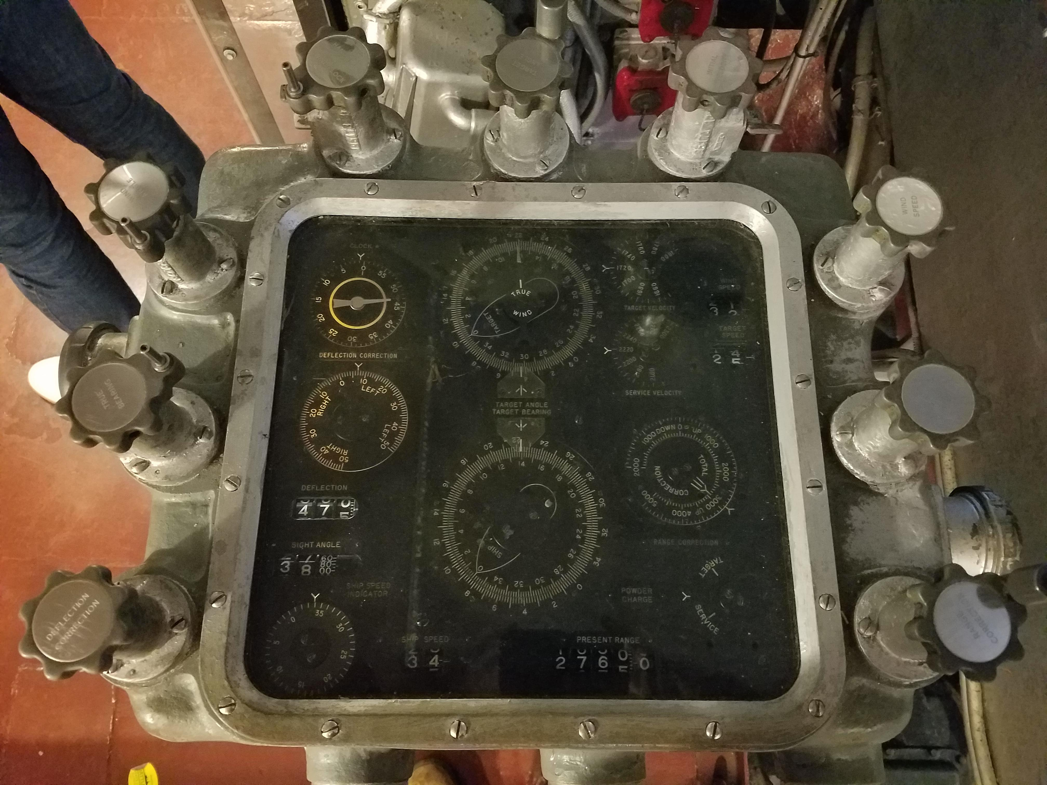
Solving Problems in History

Slide 3
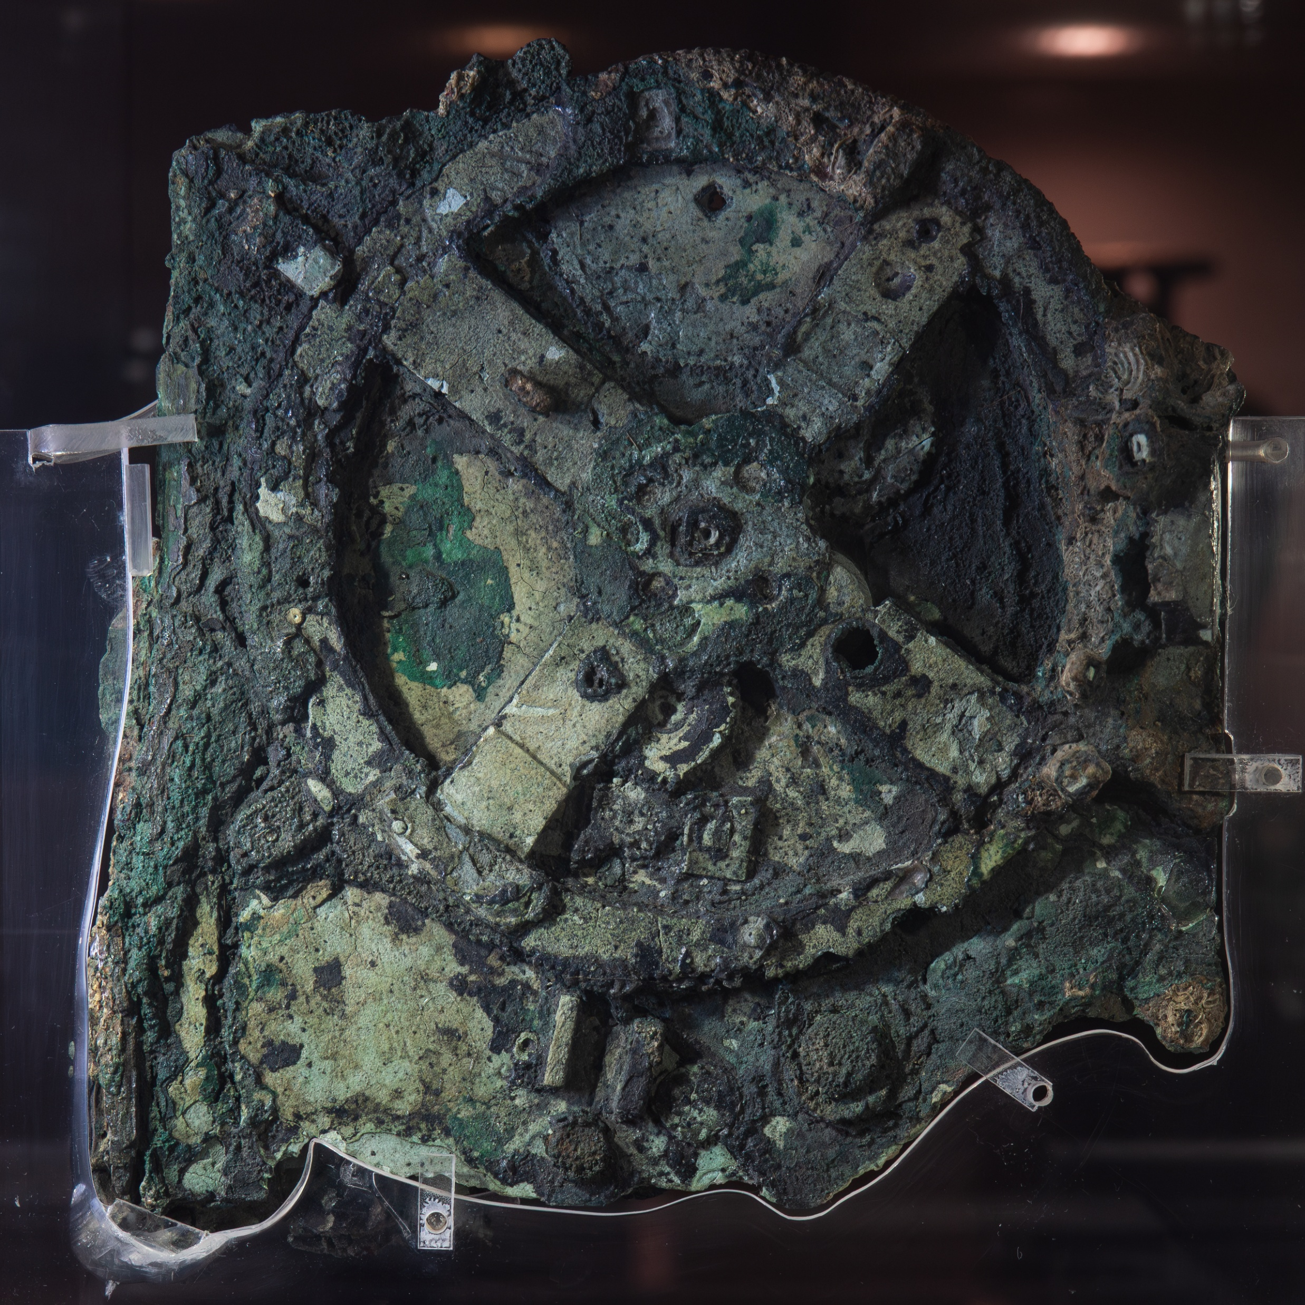
~2100 years ago

Slide 4
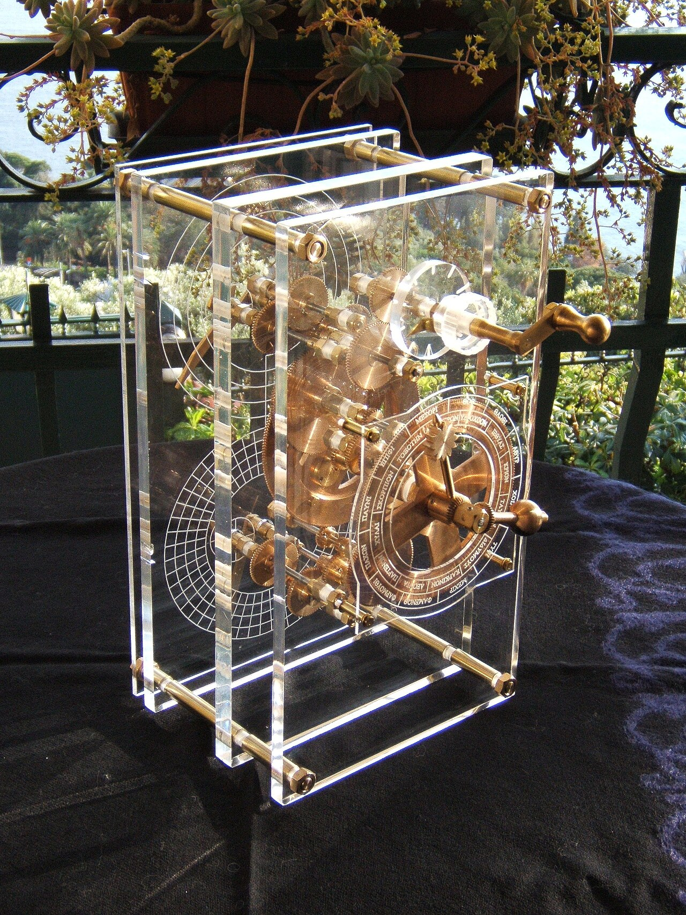

Slide 5
Mechanical, Analog, etc
These computers are built to do a specific task
Sometimes can be reconfigured by changing gears etc, but not a general-purpose computer.

Slide 6
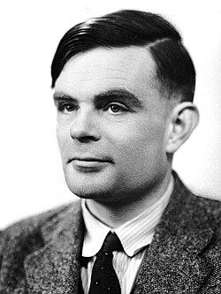
Turing Complete Machines
A system is Turing complete if it can compute any algorithm, given enough time and memory.

Slide 7
e.g., NOT Turing complete
A “straight line” machine capable of calculations without branches:
x = a + b;
y = x * 3;
z = y - 1;

Slide 8
Minimum Viable Turing Machine
State (something that changes)
Conditional behavior
Unbounded repetition
Ability to read/write memory

Slide 9
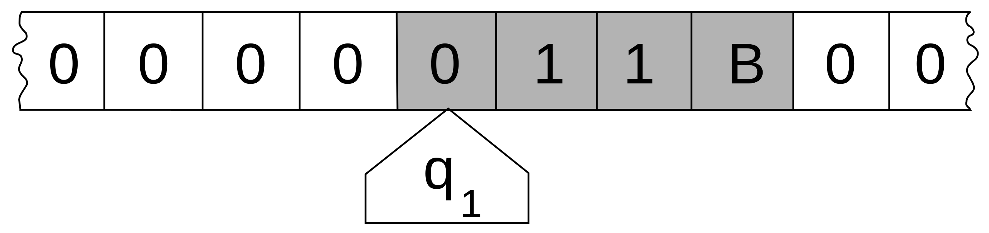
Minimum Viable Turing Machine

Slide 10
e.g., Turing Complete Things
C/C++
Arm Assembly Code
PowerPoint
Excel
The x86 “mov” instruction

Slide 11
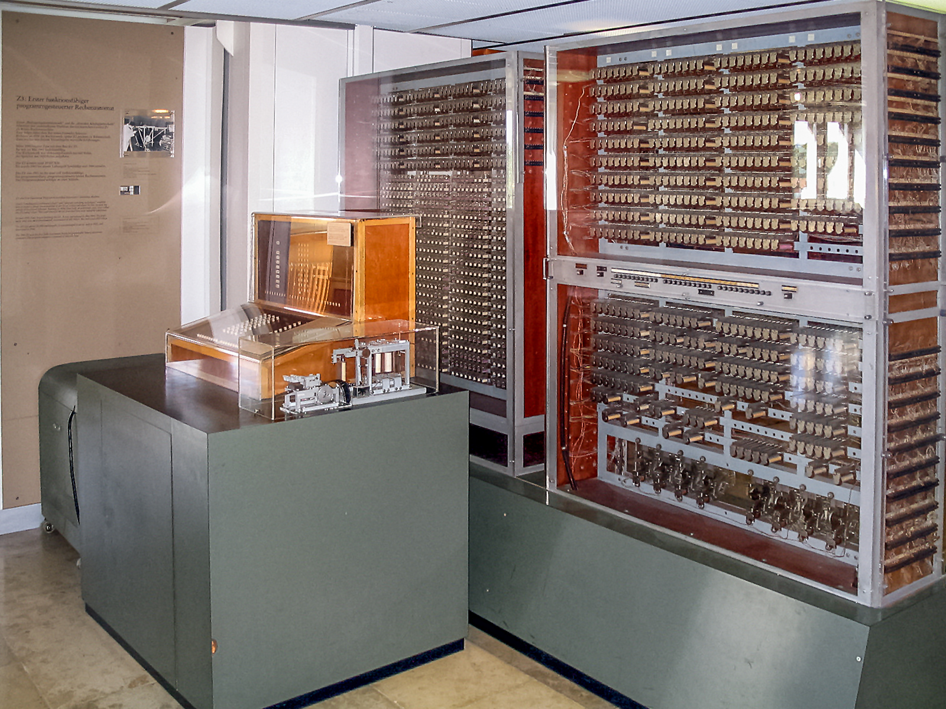
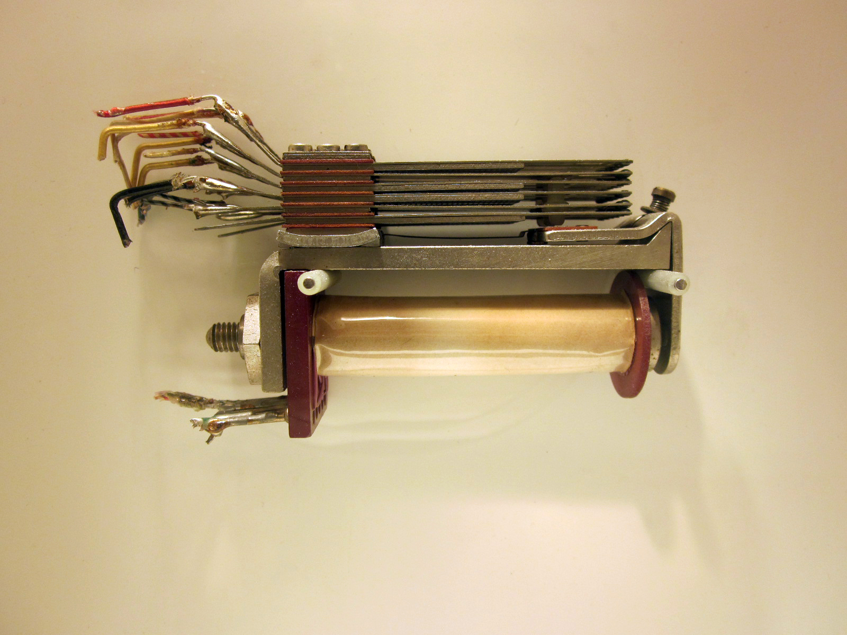
1st Turing Complete Machine (ish)
The Zuse Z3 (1941)

Slide 12
Zuse Z3
ISA Summary:
Two registers (R1, R2)
Load memory to register
Arithmetic operation on R1 & R2
Store R1 & R2 to memory
No conditional branch instruction
The machine isn’t by design Turing-complete – as a bit of a hack it can be made Turing-complete by running operations to cancel out some.
Despite this – shows early idea of an instruction set

Slide 13

ENIAC
Designed for artillery firing tables
Online in December 1945
Included a conditional branch – this was the first Turing-complete machine by design in operation.

Slide 14
Ultimate RISC
It is possible to build a computer with one instruction.
Called One Instruction Set Computer (OISC)
There is many of them: https://en.wikipedia.org/wiki/One-instruction_set_computer
E.g., FlipJump

Slide 15
FlipJump
https://esolangs.org/wiki/FlipJump
Opcode: Flips a bit, then jump (unconditionally)
Arguments: a;b
not *a; jump b

Slide 16
e.g., a FlipJump program
1000;256 // addresses 000-127
32;446 // addresses 128-255
128;256 // addresses 256-383
(Open Excel Example Program)
→ Because flipping a bit can change jump, we ultimately get storage, conditional execution, etc

Slide 17
C to FlipJump Compiler
https://github.com/tomhea/c2fj
Yes you can compile C code to this!

Slide 18
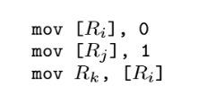
x86 “mov” instruction
https://github.com/LeetArxiv/ImplementedPapers/blob/main/mov-is-turing-complete.pdf
Comparison of Ri & Rj:

Slide 19
x86 “mov” instruction as Comparison
Remember – x86 is CISC, so memory-register architecture
If Ri = Rj (e.g., == 123)
Store “0” to address 123
Store “1” to address 123 (overwrite the “0”)
Load address 123 (which now has “1”) to Rk

Slide 20
x86 “mov” instruction as Comparison
Remember – x86 is CISC, so memory-register architecture
If Ri != Rj (e.g., Ri == 123, Rj == 124)
Store “0” to address 123
Store “1” to address 124
Load address 123 (which has “0”) to Rk

Slide 21
Turing Completeness?
Having a conditional normally means we can end up with a Turing complete machine.

Slide 22
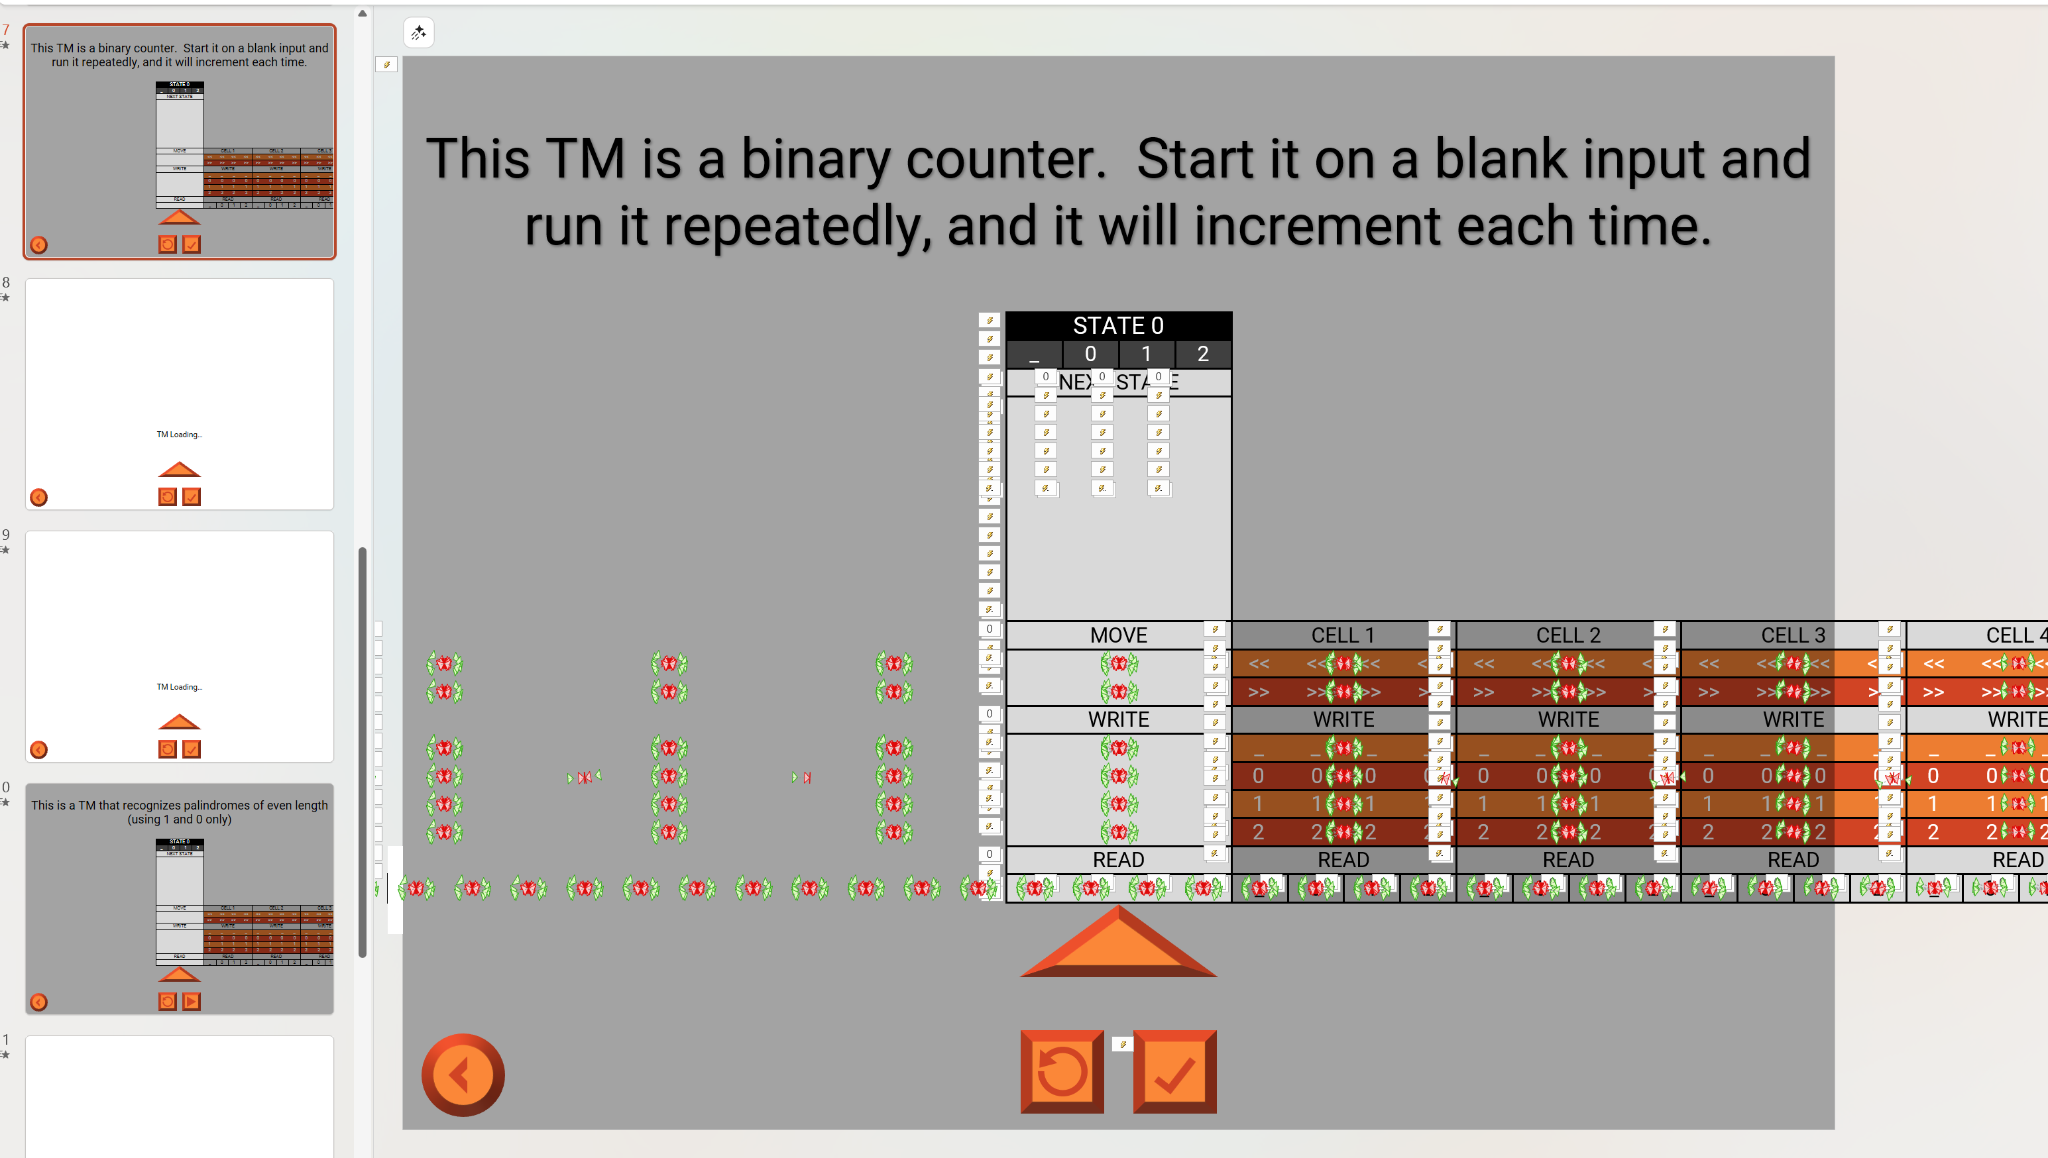
PowerPoint as Turing Machine
https://www.youtube.com/watch?v=uNjxe8ShM-8
https://esolangs.org/wiki/(P%E2%84%A2TM%E2%84%A2)%E2%84%A2

Slide 23
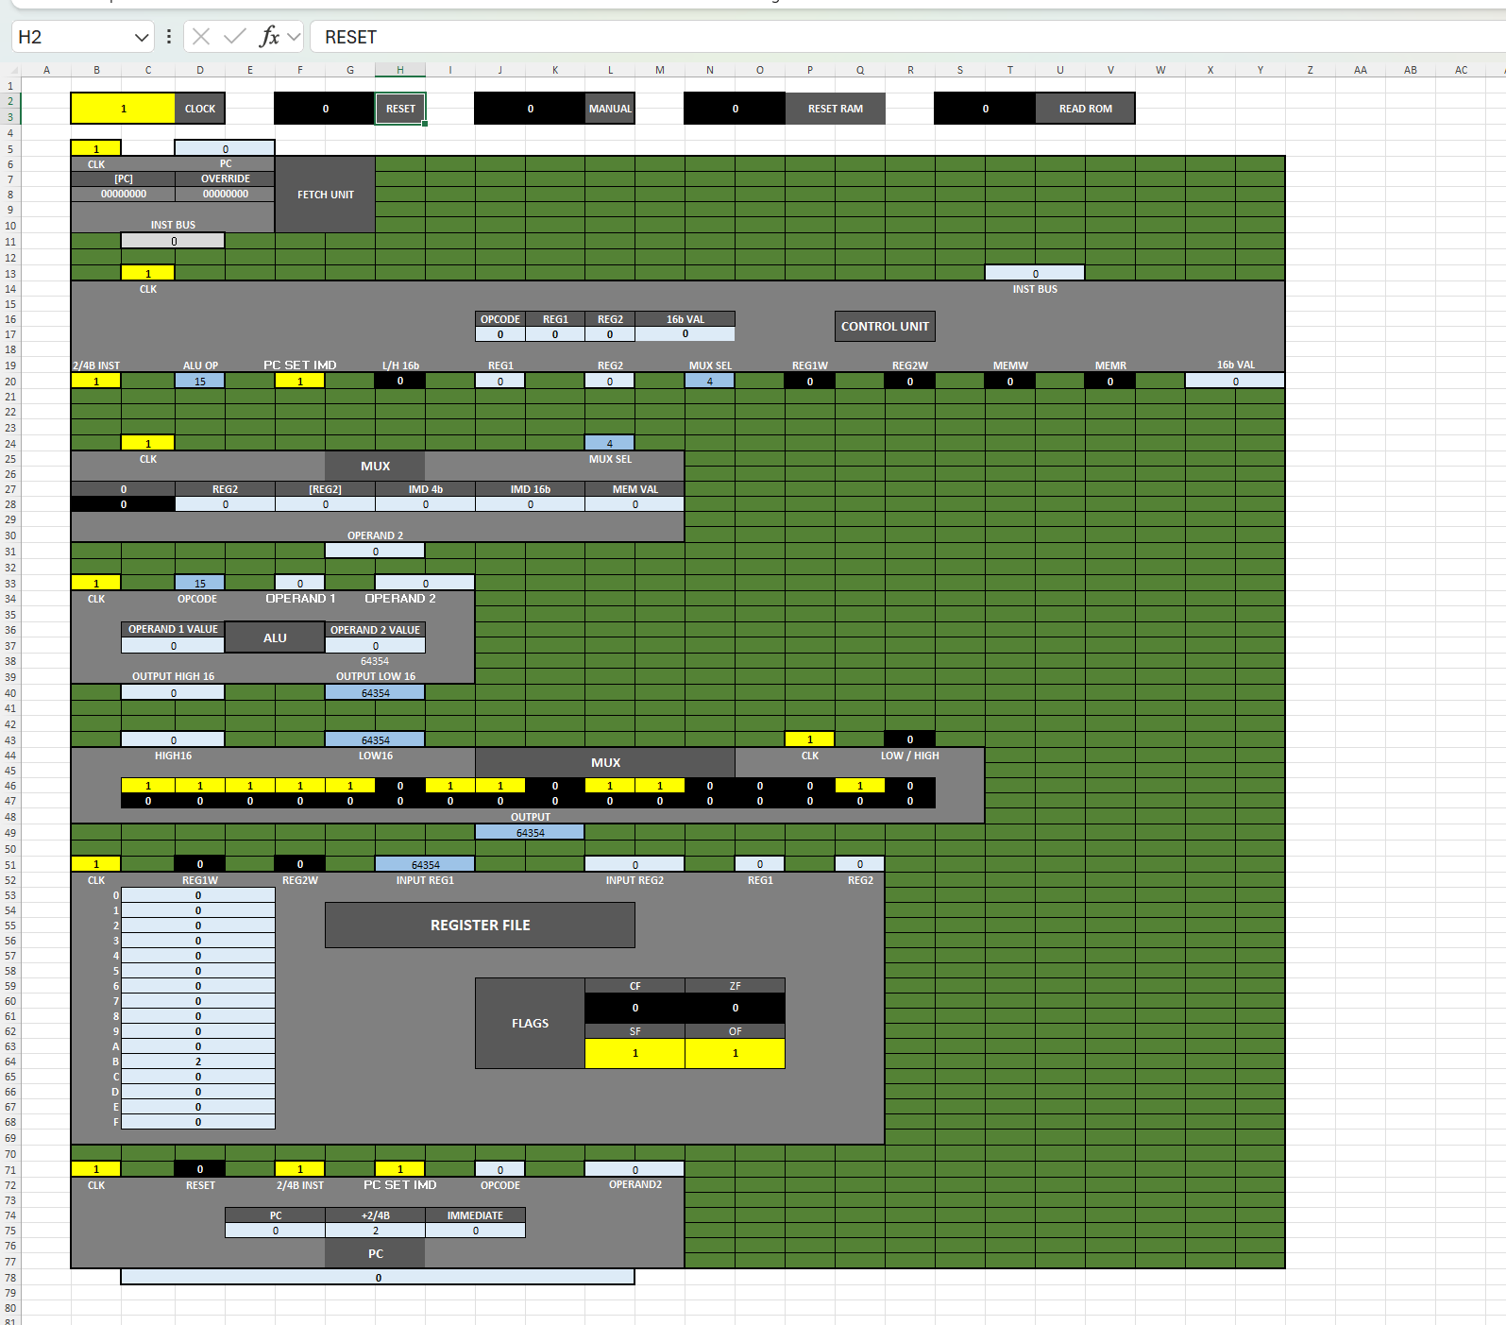
Excel 16-bit Computer
https://github.com/InkboxSoftware/excelCPU
Yes you could be taught this course with only excel.
No this wouldn’t be useful for your career!

Slide 24
Performance?
None of this talks about performance.
Most work you do in CA is related to making reasonable (useful) performance.
(Almost) anything can compute – but how fast and with how many instructions is where most of our work is.

Slide 25
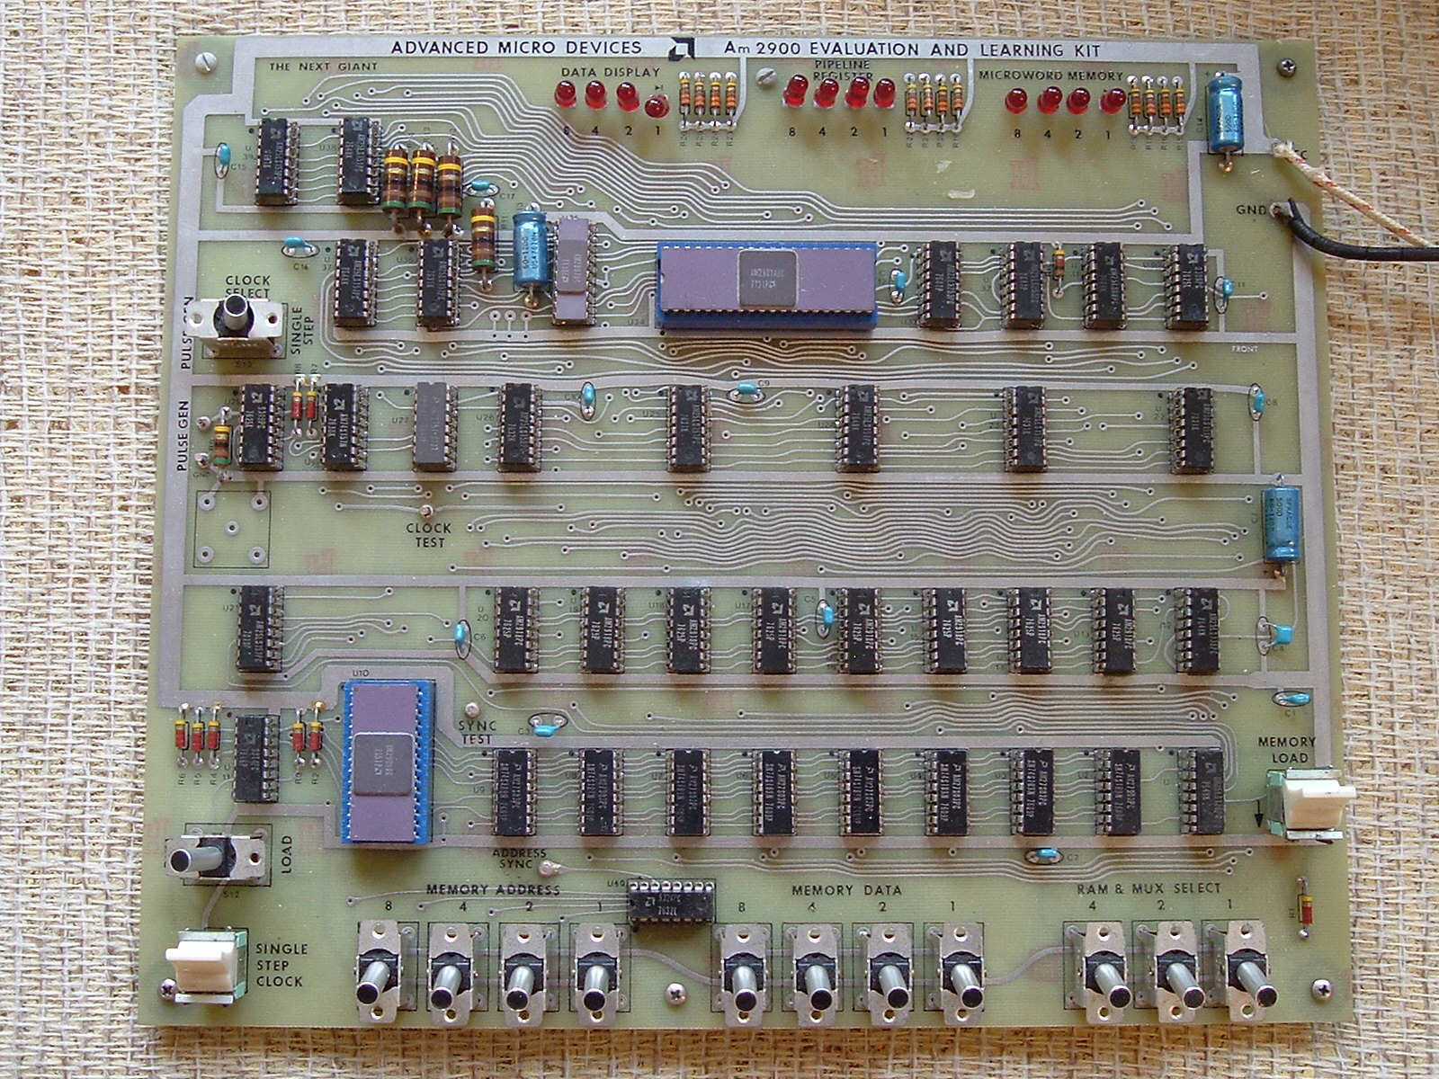
e.g.: Early CPU Trainers
https://www.donnamaie.com/AMD_Vintage/AMD_2900_ED2900A.html

Slide 26
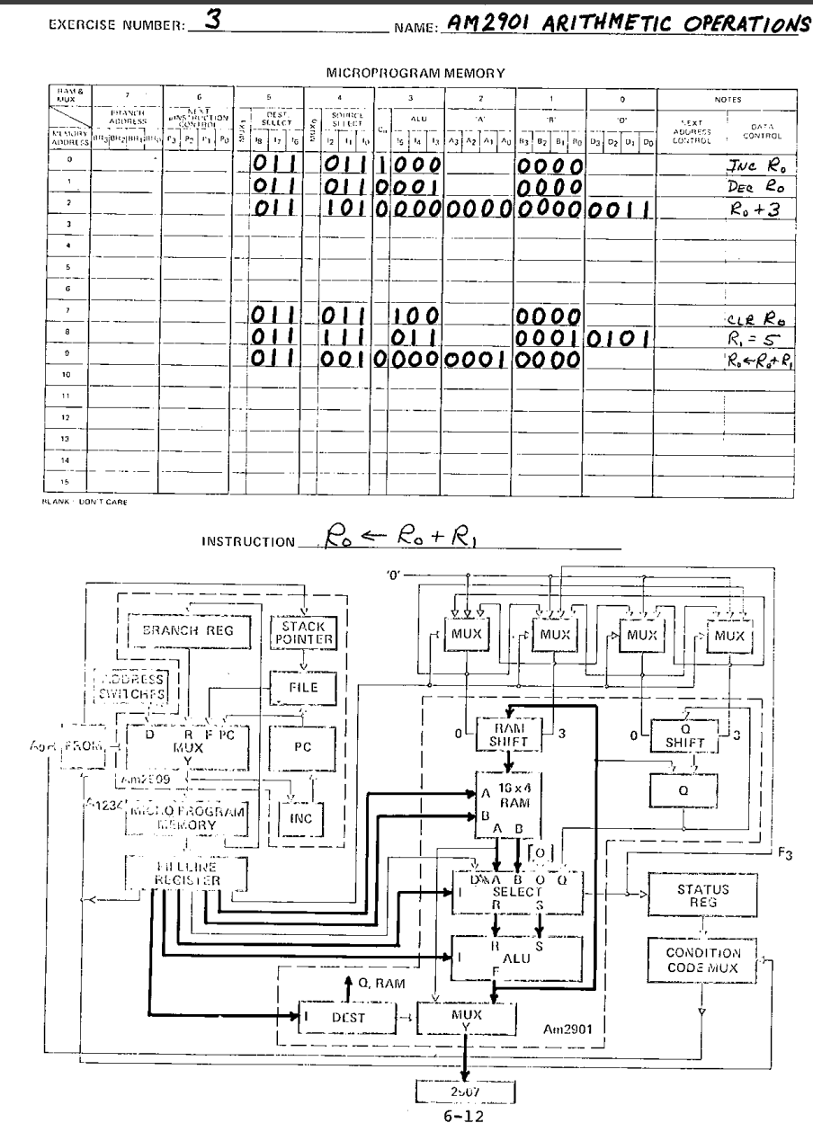

Slide 27
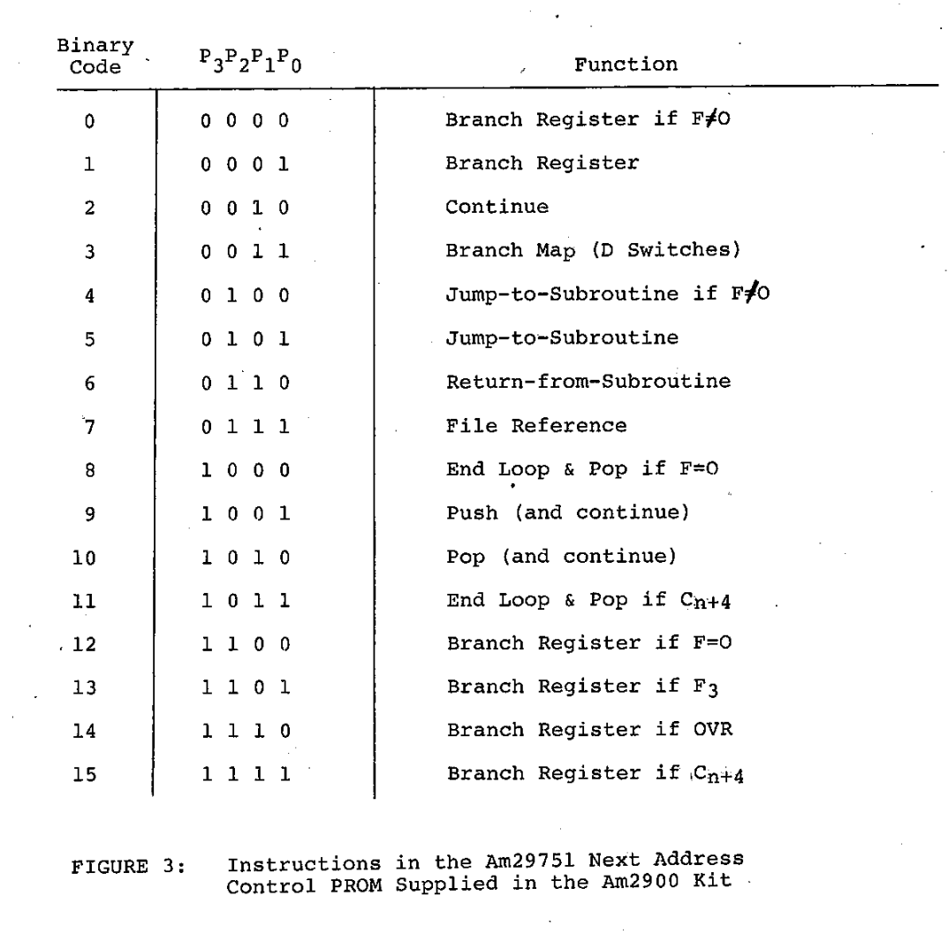

Slide 28
Summary
Turing Complete is the minimum viable requirement for something to execute arbitrary code.
Turing Complete does not mean this is practical or speedy.
Even early processors considered performance – the fundamentals we will cover have been considered since the introduction of the field

